Slide 1

®
National Income:
Where It Comes From and Where It Goes

Slide 2
Gross Domestic Product
Gross Domestic Product is a measure of how well the economy is performing. The Central Statistical Organization (part of the GoI’s Dept. of MOSPI) calculates GDP via administrative data, which are byproducts of government functions such as tax collection, education programs, defense, and regulation, and statistical data, which come from government surveys of, for example, NSSO, ASI, retail establishments manufacturing firms and farm activity.

Slide 3
GROSS DOMESTIC PRODUCT (GDP)
It is the value of all final goods and services produced for the marketplace during a given time period within a country's borders.

Slide 4
The GDP in India is calculated using two different methods
1st method is based on economic activity (at factor cost), and the 2nd is based on expenditure (at market prices)
Following 8 industry sectors are considered in the 1st method:
  Agriculture, forestry and fishing;
  Mining and quarrying;
  Manufacturing;
  Electricity, gas and water supply;
  Construction;
  Trade, hotels, transport and communication;
  Financing, insurance, real estate and business services;
  Community, social and personal services.

Slide 5
(Rupees Billion)
Year | Quarter | Agriculture & allied | Mining & Quarrying | Manufacturing | Electricity, Gas & Water Supply | Construction | Trade, hotels, transport & communication | Finance, Insuranc, Real Estate & Business Services | Community, Social & Personal Services | GDP fc
2007-08 | Q1 | 1279.60 | 142.83 | 1131.11 | 159.18 | 539.99 | 1981.68 | 1093.40 | 932.07 | 7259.86
 | Q2 | 1024.96 | 138.10 | 1154.99 | 157.88 | 548.56 | 2026.22 | 1116.34 | 1015.04 | 7182.10
 | Q3 | 1827.38 | 159.46 | 1203.50 | 159.06 | 576.88 | 2252.30 | 1154.84 | 983.95 | 8317.37
 | Q4 | 1439.26 | 179.60 | 1273.43 | 161.18 | 597.82 | 2493.81 | 1211.26 | 1181.49 | 8537.85
2008-09 | Q1 | 1318.49 | 149.41 | 1193.32 | 163.55 | 585.54 | 2238.62 | 1169.02 | 1008.24 | 7826.20
 | Q2 | 1052.14 | 143.21 | 1213.61 | 163.84 | 601.01 | 2271.28 | 1187.39 | 1106.02 | 7738.50
 | Q3 | 1811.97 | 167.33 | 1214.35 | 164.64 | 600.90 | 2384.67 | 1250.67 | 1205.26 | 8799.80
 | Q4 | 1477.83 | 182.50 | 1256.11 | 166.95 | 638.30 | 2651.34 | 1326.48 | 1329.73 | 9029.24
2009-10 | Q1 | 1349.68 | 161.19 | 1234.48 | 173.67 | 627.13 | 2419.61 | 1263.22 | 1076.60 | 8305.57
 | Q2 | 1061.16 | 156.88 | 1324.92 | 176.04 | 639.83 | 2464.52 | 1278.44 | 1246.02 | 8347.80

Slide 6


Rules for Computing GDP
1) To compute the total value of different goods and services, the national income accounts use market prices.
Thus, if:
$0.50
$1.00
GDP = (Price of apples × Quantity of apples)
+ (Price of oranges × Quantity of oranges)
= ($0.50 × 4) + ($1.00 × 3)
GDP = $5.00
2) Used goods are not included in the calculation of GDP.
3) The treatment of inventories depends on if the goods are stored or
if they spoil. If the goods are stored, their value is included in GDP.
If they spoil, GDP remains unchanged. When the goods are finally sold out of inventory, they are not counted.

Slide 7
More Rules for Computing GDP
4) Intermediate goods are not counted in GDP– only the value of
final goods. Reason: the value of intermediate goods is already
included in the market price.
Value added of a firm = the value of the firm’s output - the value of the intermediate goods the firm purchases.
5) Some goods are not sold in the marketplace and therefore don’t
have market prices. We must use their imputed value as an estimate
of their value. For example, home ownership and government services.

Slide 8
Real Vs. Nominal GDP
The value of final goods and services measured at current prices is called nominal GDP.
Nominal GDP Y = P × y
This distinction between real and nominal can also be applied to other monetary values, like wages.
This conversion from nominal to real units allows us to eliminate the problems created by having a measuring stick (dollar value) that essentially changes length over time, as the price level changes.

Slide 9
How real GDP is computed in our apple & orange economy?
If we want to compare output in 2009 and output in 2010, we would need base-year prices, i.e. 2009 prices.
Real GDP in 2009 would be:
(2009 Price of Apples × 2009 Quantity of Apples) +
(2009 Price of Oranges × 2009 Quantity of Oranges).
Real GDP in 2010 would be:
(2009 Price of Apples × 2010 Quantity of Apples) +
(2009 Price of Oranges × 2010 Quantity of Oranges).
Real GDP in 2011 would be:
(2009 Price of Apples × 2011 Quantity of Apples) +
(2009 Price of Oranges × 2011 Quantity of Oranges).
Note that 2009 prices are used to compute real GDP for all three years. Because prices are held constant from year to year,
real GDP varies only when the quantities produced vary.

Slide 10
GDP Deflator
THE IMPLICIT PRICE DEFLATOR FOR GDP
GDP Deflator = Nominal GDP
Real GDP
Nominal GDP measures the current dollar value of the output of
the economy.
Real GDP measures output valued at constant prices.
The GDP deflator, also called the implicit price deflator for GDP,
measures the price of output relative to its price in the base year. It
reflects what’s happening to the overall level of prices in the economy.

Slide 11
Assume a U.S. dealer bought 100 TVs from South Korea for $250 each in 2006. He subsequently sold 80 of them in 2006 for $450 each, and the rest in 2007 for $400 each. By how much was the U.S. GDP affected in 2006?
a. $45,000
b. $36,000
c. $19,000
d. $16,000
e. $11,000

Slide 12
Components of Expenditure
Y = C + I + G + NX
Total demand
for domestic
output (GDP)
Investment
spending by
businesses and
households
Net exports
or net foreign
demand
Consumption
spending by
households
Government
purchases of goods
and services
This is the called the national income accounts identity.

Slide 13
GDP and Its Components
Let in 2017, Indian GDP totaled about 13.8 trillion. This number is incomprehensible. So, if we divide this number by the total population of say 302 million, we get GDP per person—the amount of expenditure for the average Indian – which equaled Rs. 45,707 in 2017.
Let’s break it down visually on the next slide.

Slide 14
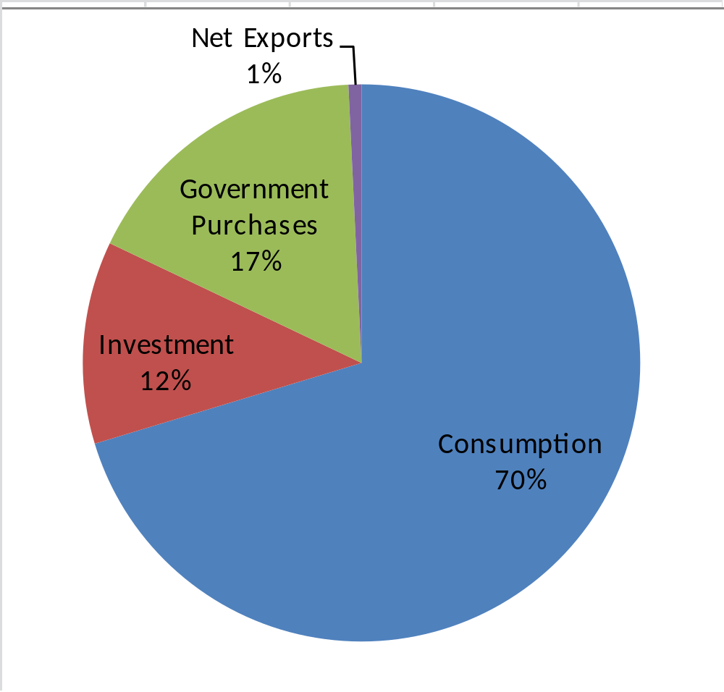
GDP (Y) was Rs.45, 707 per person
Y = C + I + G + NX
$45,707 = $31,995 + $5485 + $7,770 + $457

Slide 15
We begin with firms and see what determines their level of production (therefore, the level of national income).
Next, we consider how much of this income households consume and how much they save. We will also discuss the demand arising from investment and government purchases. Finally, we discuss how the demand and supply for goods and services are brought into balance.

Slide 16
Quick Recap….
In national Income Accounts what is the difference between?
A firm’s buying an auto for an executive and the firm paying the executive additional income to buy the car by herself.
Your hiring your spouse rather than having him/ her do the work without pay.
You decided to study M.Tech from Stanford University as against IIT, B.

Slide 17
The expenditure (at market prices) method involves summing the domestic expenditure on final goods and services across various streams during a particular time period.
It includes consideration of expenses towards household consumption, investments, government costs, and net trade (exports minus imports).

Slide 18
What determines the Total Production of Goods and Services?
An economy’s output of goods and services (GDP) depends on:
quantity of inputs The Factors of Production
ability to turn inputs into output The Production Function
technology

Slide 19
The Factors of Production
The factors of production are the inputs used to produce goods and services. The two most important factors of production are capital and labor. In this module, we will take these factors as given
K (capital) = K
L (labor) = L

Slide 20

The available production technology determines how much output is produced from given amounts of capital (K) and labor (L)..
We write the production function as: Y = F ( K , L )

Slide 21
How is NI distributed among Factors of Production?
The total output of an economy equals total income.
Because the factors of production and the production function
together determine the total output of goods and services, they also
determine national income.
FACTOR PRICES
Factor prices are the amounts paid to the factors of production—the wages workers earn and the rent the owners of capital collect.

Slide 22
The price paid to any factor of production typically depends on the supply and demand for that factor’s services.
So, demand for workers determine wages, demand for land determine rent, etc..

Slide 23
Income, Expenditure, and the Circular Flow
Two ways
of viewing GDP
Total income of everyone in the economy
Total expenditure on the economy’s
output of goods and services
Income $
Labor
Households
Firms
Goods
Expenditure $
For the economy as a whole, income must equal expenditure.
GDP measures the flow of dollars in the economy.

Slide 24
The goal of the firm is to maximize profit. Profit is revenue minus
cost.
Revenue equals P × Y.
Costs include both labor and capital costs.
Labor costs = W × L, the wage multiplied by the amount of labor L.
Capital costs = R × K, the rental price of capital R times the amount of capital K.
Profit = Revenue - Labor Costs - Capital Costs
= P.Y - W.L - R.K

Slide 25
What determines the demand and supply of goods and services?
Y = C + I + G + NX
Investment
spending by
businesses and
households
Total demand
for domestic
output (GDP)
Net exports
or net foreign
demand
Consumption
spending by
households
Government
purchases of goods
and services
We are going to assume our economy is a closed economy, therefore it eliminates the last-term net exports, NX. So, the three components of GDP are Consumption (C), Investment (I) and Government purchases (G). Let’s see how GDP is allocated among these three uses.

Slide 26
C =C_{d} + C_{f}
I = I_{d} + I_{f}
G= G_{d} + G_{f}
Y = C + I + G + X- (C_{f} + I_{f} + G_{f})
or, Y = C + I + G + (X - IM)

Slide 27
The Consumption Function
C = C(Y- T)
C
C = C( Y-T)
disposable
income
depends
on
consumption
spending by
households
Y - T
The slope of the consumption function is the MPC.

Slide 28
The Marginal Propensity to Consume
The marginal propensity to consume (MPC) is the amount by which consumption changes when disposable income (Y - T)
increases by one dollar.
To understand the MPC, consider a shopping scenario. A person who loves to shop probably has a large MPC, let’s say ($.99). This means that for every extra dollar he or she earns after tax deductions, he or she spends $.99 of it.

Slide 29
Multipliers……
The government-purchases multiplier:
ΔY/ΔG = 1 + MPC + MPC² + MPC³ + …
ΔY/ΔG = 1 / 1 - MPC

Slide 30
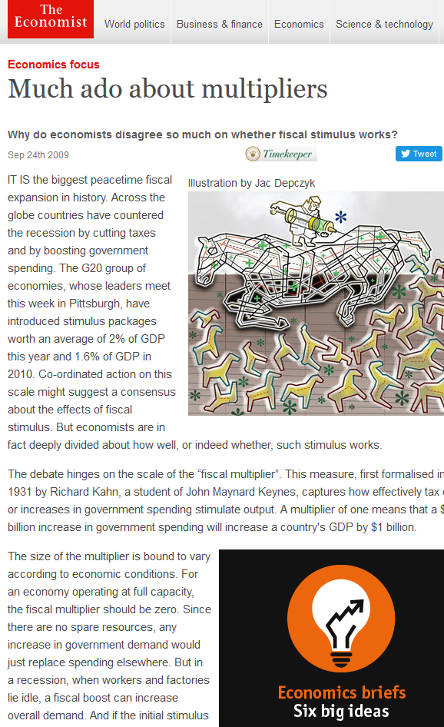

Slide 31
The Investment Function
I = I(r)
Investment
spending
depends
on
real interest rate
The quantity of investment depends on the real interest rate, which measures the cost of the funds used to finance investment.

Slide 32
Investment depends on the real interest rate r because it is the cost of borrowing. The investment function slopes downward; when the interest rate rises, fewer investment projects are profitable.
Real
interest
rate, r
Investment function, I(r)
Quantity of investment, I

Slide 33
Government Purchases
We take the level of government spending and
taxes as given.
If government purchases equal (taxes minus transfers), then G = T, and the government has a balanced budget.
If G > T, then the government is running a budget deficit.
If G < T, then the government is running a budget surplus.
G = G
T = T

Slide 34
What Brings the Supply and Demand
for Goods and Services Into Equilibrium?
The following equations summarize the discussion of the demand
for goods and services:
1) Y = C + I + G Demand for Economy’s Output
2) C = C(Y - T) Consumption Function
3) I = I(r) Real Investment Function
4) G = G Government Purchases
5) T = T Taxes

Slide 35
To this analysis, let’s add what we’ve learned about the supply
of goods and services earlier in the module. There we saw that the factors of production and the production function determine the quantity of output supplied to the economy:
Y = F (K, L)
= Y
Now, let’s equate to this the demand for the output. So we obtain:
Y = C(Y - T) + I(r) + G
This equation states that the supply of output equals its demand,
which is the sum of consumption, investment,
and government purchases.

Slide 36
Changes in Saving: The Effects of Fiscal Policy
An Increase in Government Purchases: If we increase government
purchases by an amount dG, Demand will .
As disposable (Y-T) is unchanged, C is unchanged.
The rise in government purchases must be met by in I.
To induce I to fall, the interest rate must rise. Hence, the rise
in government purchases causes the r to and I to
Thus, government purchases are said to crowd out investment.

Slide 37
A Decrease in Taxes:
The immediate impact of a tax cut is to raise disposable income and thus to raise consumption.
Disposable income rises by dT, and consumption rises by an amount equal to dT times the MPC.
The higher the MPC, the greater the impact of the tax cut on consumption.
As the govt’s revenue falls, it has to borrow money, hence r increases. This reduces I.
So, government purchases, tax cuts crowd out investment.

Slide 38
Gross Domestic Product
How Investment Is Financed?
  Investment is financed from three sources:
  Private saving, S
  Government budget surplus, (T – G)
  Borrowing from the rest of the world (M – X)
Notes:
How investment is financed. Don’t skimp on this topic. It provides the foundation for what the student will meet in Chapter 23 (Chapter 8 in the macro text).

Slide 39
Gross Domestic Product
  The three sources of investment finance comes from the fact that aggregate expenditure equals aggregate income.
  Start with
  Y ≡ C + S + T = C + I + G
  Then rearrange to obtain
  I = S + (T – G)
  Private saving S plus government saving (T – G) is called national saving.

Slide 40
Limitations of GDP ?

